Slide 1



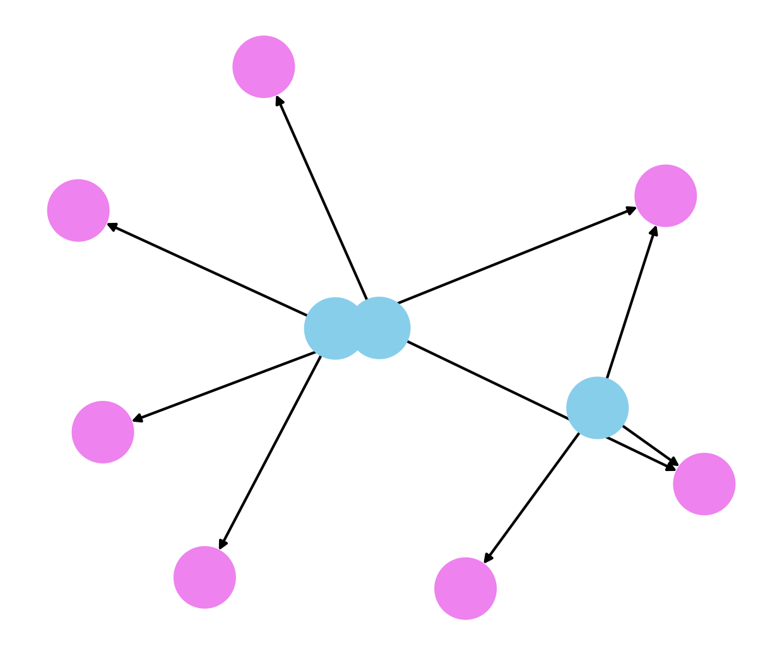
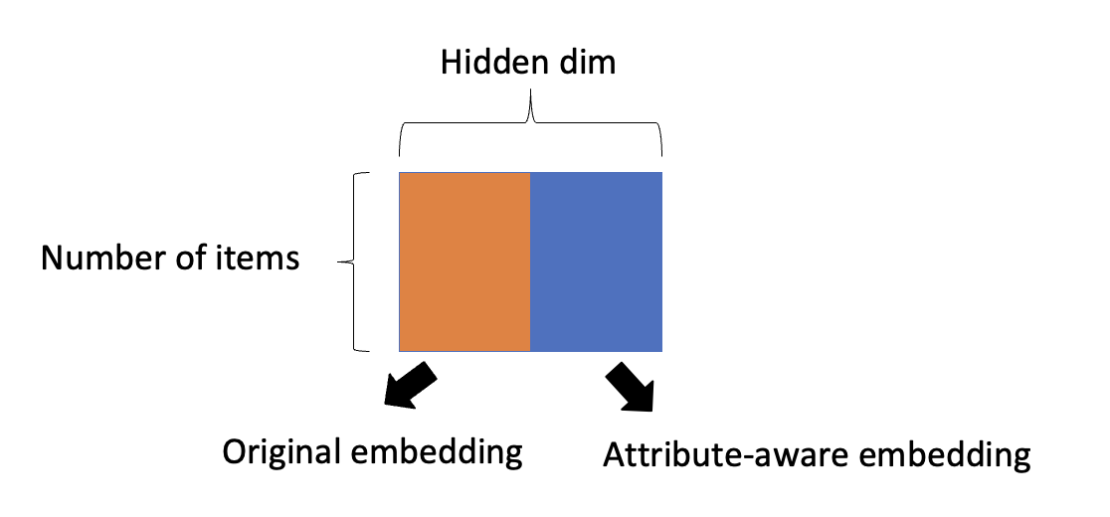
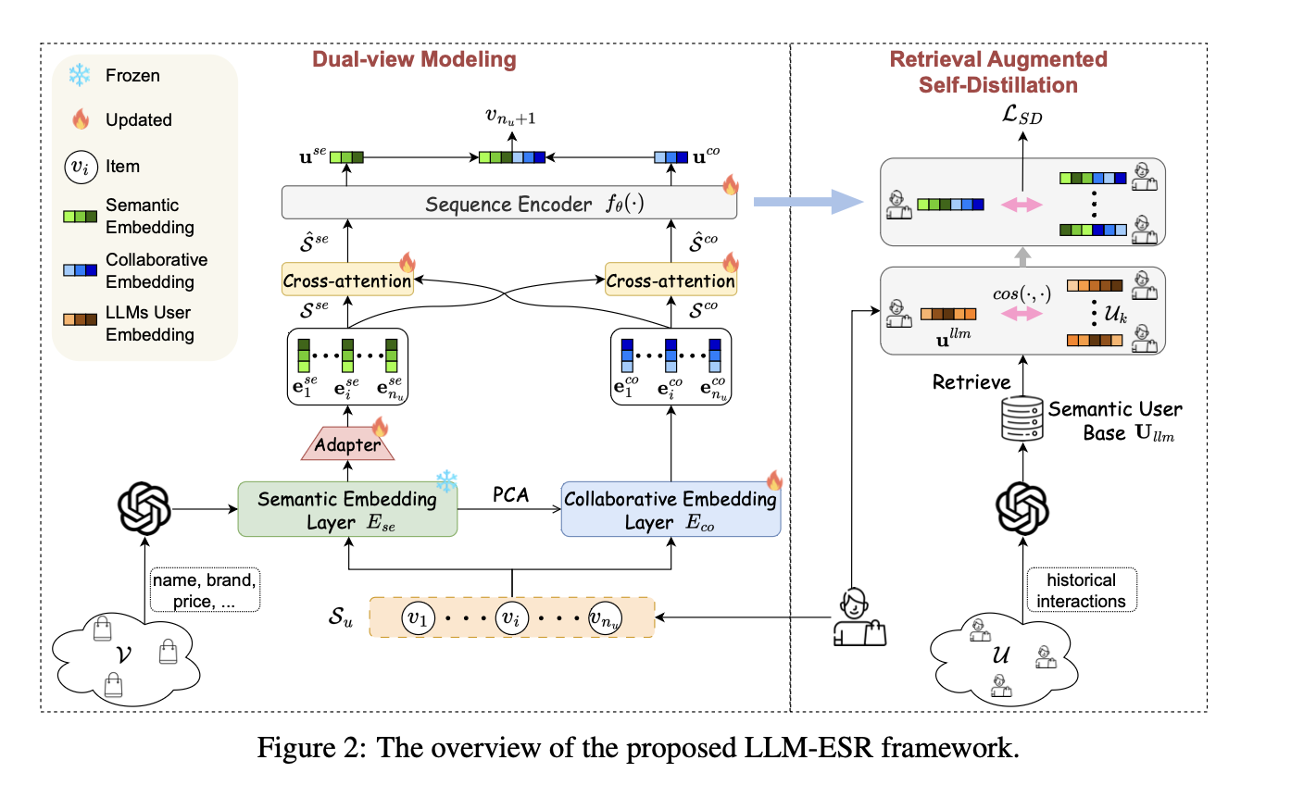
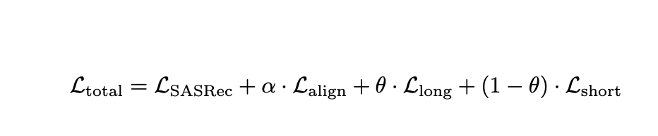
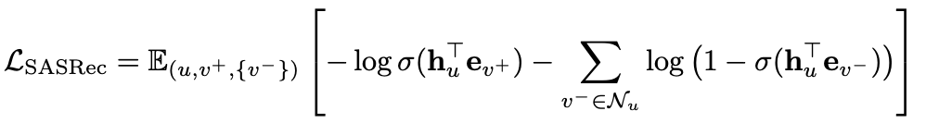
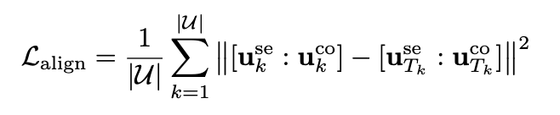


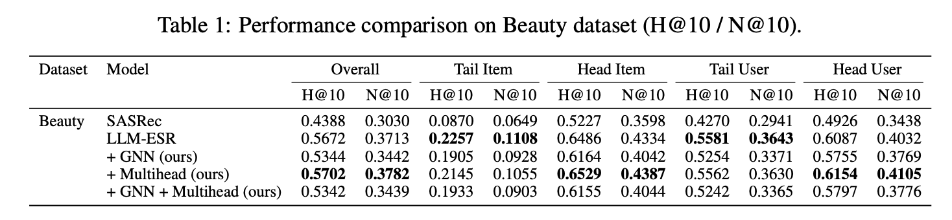
LLMESR-Pro: Attribute-aware Graph Embedding and Tail-aware Prediction for Sequential Recommendation
Code Available
A collaborative final project across CSCI-SHU 381: Recommendation Systems and DATS-SHU 369: Machine Learning with Graphs, supervised by Prof. Hongyi Wen and Prof. Qiaoyu Tan.
Ninghao Lu nl2752@nyu.edu
Original Method
Our Method
LLM-ESR leverages dual-view modeling (LLM-based semantic and trainable collaborative embeddings) and retrieval-augmented self-distillation to address the challenges of long-tailed sequential recommendation. (i) It uses frozen LLMs to extract item embeddings via prompts, forming the semantic view. (ii) It initializes collaborative embeddings, fuses the two views, and uses a single prediction head within a sequential model to score candidate items. (iii) It introduces self-distillation to enhance the representations of long-tail users by retrieving similar users as soft teachers.
Attribute-aware Graph Embedding
We construct a heterogeneous graph where Nodes are items and attributes (e.g., brand, category, price), Edges encode typed relations such as has-brand, has-category, and has-price (plus reverse edges). Then we train a GAT model to inject structural information into embeddings with a contrastive loss. The learned structure-aware item embeddings are then concatenated with the collaborative view embeddings, and projected into a shared space for downstream recommendation.
Tail-aware Prediction
We split users into head and tail categories based on their interaction frequency. In addition to the original prediction head, we introduce two specialized prediction heads for each user type. During inference, we combine the prediction scores from the shared head and the user-specific head using a weighted sum, allowing the model to better tailor its predictions to user behavior patterns.
fused embedding
GAT
Concatenation
Projector
Attribute-aware embedding
Experimental results
Motivation
Motivated by LLM-ESR，we carefully studied its framework and identified 2 opportunities for further enhancement.
Limited structural modeling in item semantics: The semantic view relies purely on textual prompts to extract item embeddings using frozen LLMs, without modeling the graph structure between items and their attributes (e.g., brand, category, price).
Uniform prediction strategy for heterogeneous users: LLM-ESR adopts a single prediction head for all users, which may be suboptimal for head users because they already have rich interaction history and do not need to do self-distillation to enhance their representation.
Takeaways
Attribute-aware Graph Embedding introduces structural inductive bias by explicitly modeling item-attribute relationships (e.g., brand, category, price). However, its effectiveness is limited when the attribute connections are sparse or noisy, which can globally degrade item representation quality and hurt recommendation performance.
Tail-aware Multi-head Prediction demonstrates consistent and significant improvements. By separating prediction heads for head and tail users, the model can better capture user-specific behavioral patterns. For head users with rich interaction histories, bypassing self-distillation avoids redundant learning and helps preserve personalized signals.

